Slide 1

Vacuum Cleaning Robots
Robotics
Master in Informatics and Computing Engineering
2018/2019
Andreia Rodrigues - up201404691
Tiago Filipe - up201610655

Slide 2
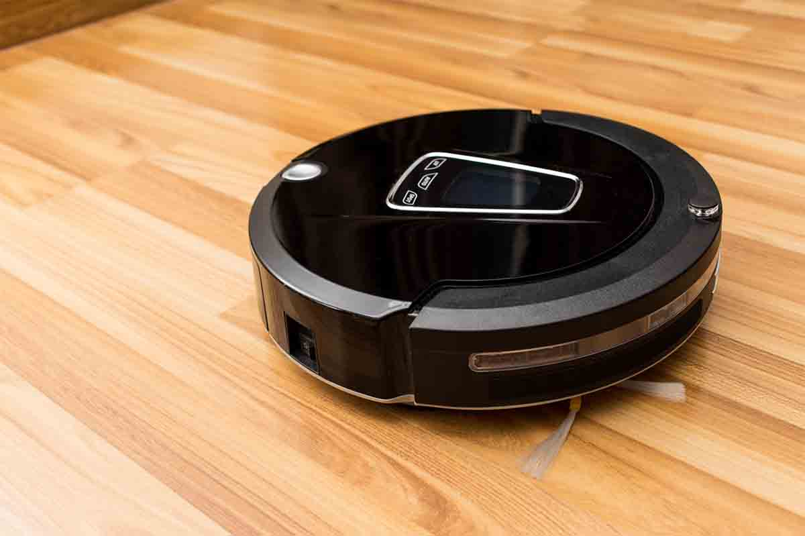
Introduction / Motivation
Currently in the domestic environment only a few types of mobile robots have been mass-produced.
First successful product:
Robotic Vacuum Cleaner
First research related: 1980s First prototype for domestic use: 1991

Slide 3
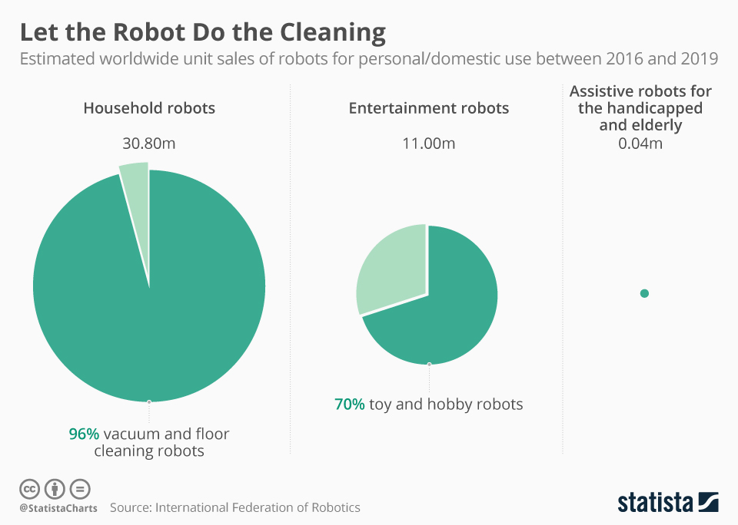
According to statistics of the International Federation of Robotics:
60 million+ personal and service robots were sold in 2016, with an increase of 24% in numbers compared to 2015
estimated continuous growth of 20-25% per following year

Slide 4
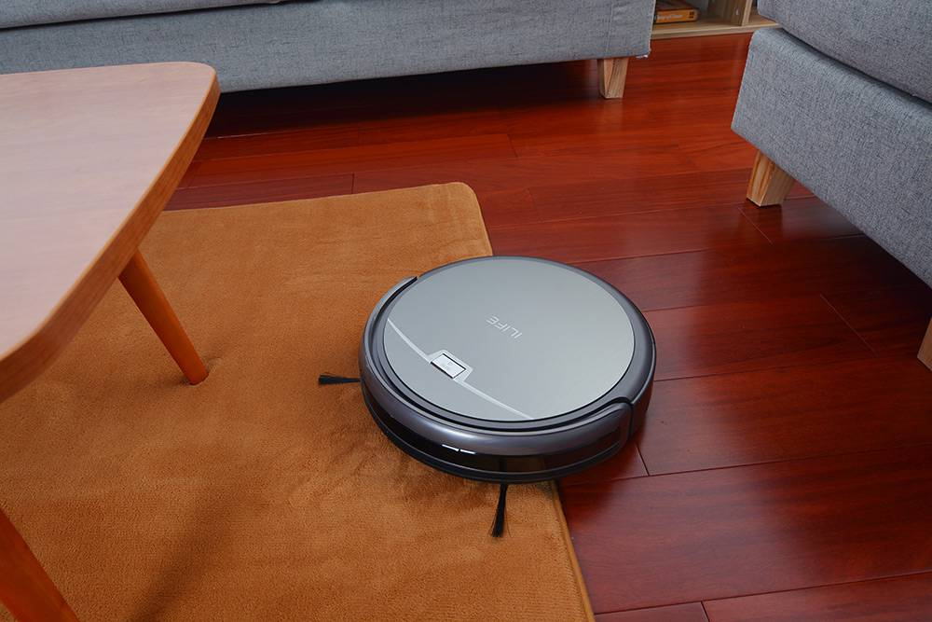
Definitions
Robotic Vacuum Cleaner (robovac): autonomous robotic vacuum cleaner which has intelligent programming and a limited vacuum cleaning system.
It is meant to perform daily or weekly touch-ups to keep your home cleaner in between regular vacuuming cycles, not to replace the standard vacuum cleaner.
It is more quiet and convenient than regular vacuum cleaners.

Slide 5
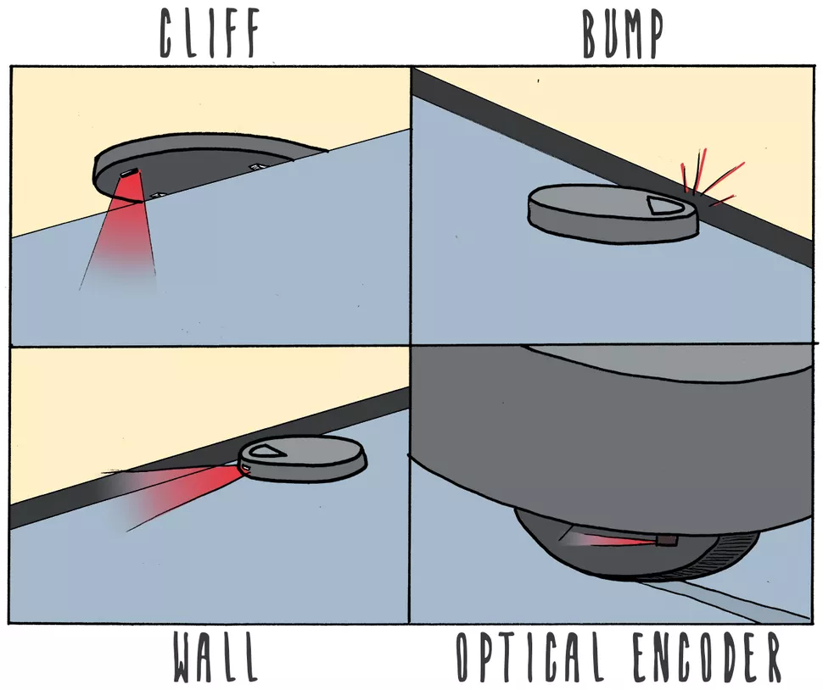

Sensors and Navigation
Cliff sensors: measure the distance between the robot base and the floor, usually by bouncing infrared light off the floor.
Bump sensors: if the robot vacuum bumps into something (like a wall or a chair leg), the impact triggers the sensor.
Wall sensors: tell the robot when it is close to a wall, so it can follow the wall.
Optical encoders: sensors on the wheels
of the robot tell it how far it has gone.
(https://www.youtube.com/watch?v=uCWeG3p5KJA)

Slide 6
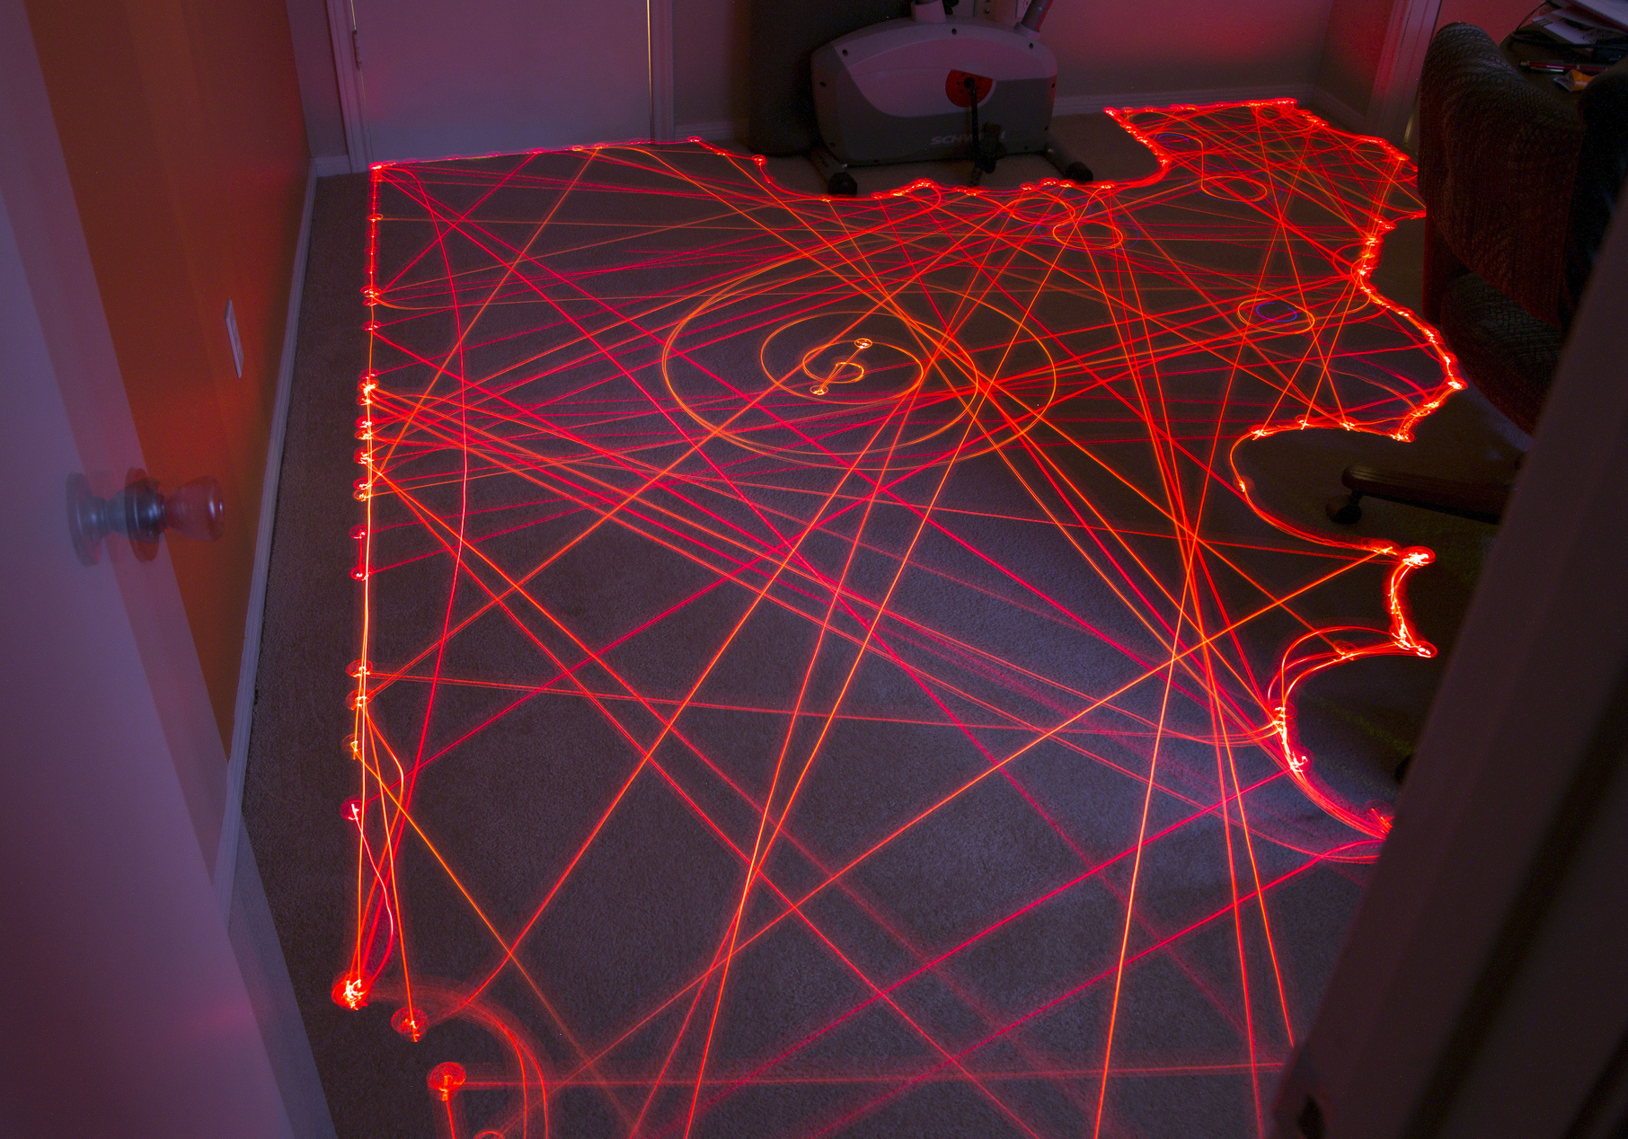
In 2002, one of the founders of iRobot started to think in robots navigation like the ant movement in real world.
Straight behaviour: Makes the robot keep going straight until it hits something.
Bounce behaviour: If the robot hits something, it should stop, turn to an angle away from the object and move straight again.
Spiral behaviour: makes it move outward in a spiral.
Wall-following behaviour: follow the wall by “bouncing” and going “straight” until the wall is constantly a certain distance away.

Slide 7
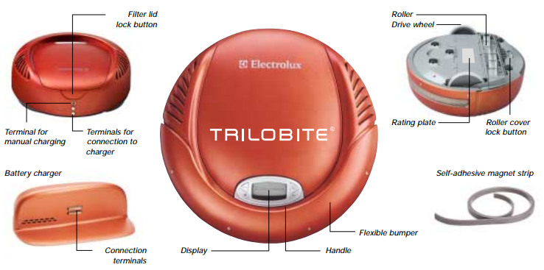
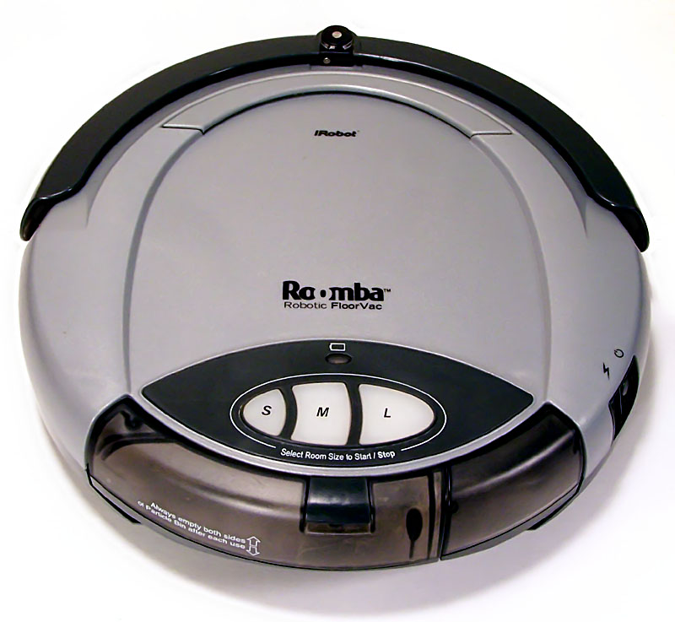
Relevant Projects
Electrolux Trilobite, 1st commercial robovac (1996)
Needs magnetic strips at doorways and near stairs.
Leaves small areas that are not fully cleaned.
Roomba, 1st big success (2002)
Detects steep drops to keep it from falling down stairs.
Changes direction when it encountered an obstacle.

Slide 8
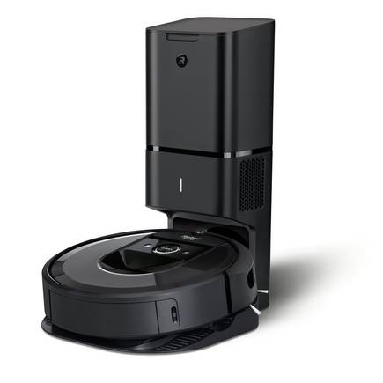
Roomba i7+ the robovac produced by iRobot in 2018.
Persists navigation maps between cleaning sessions;
Autonomously recharge and clear the vacuum system on a clean base dock.
“This robot delivers on the original vision we had when we embarked on the journey to build a vacuuming robot almost 20 years ago.”
Colin Angle, iRobot CEO
(https://www.youtube.com/watch?v=HPgxcETuqzI)

Slide 9
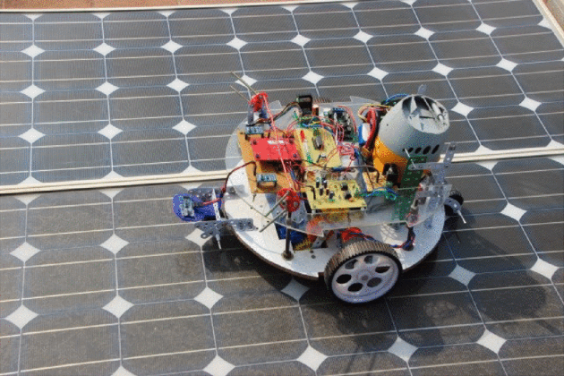
Relevant Papers
In 2014, at the Texas Instruments India Educators' Conference (TIIEC), was presented a strategy to reduce problems in the lifetime and efficiency of a solar panel.
Two-stage cleaning process:
Agitating and pushing the dust towards the vacuum cleaner;
Collecting the dust scattered on the solar panel.

Slide 10
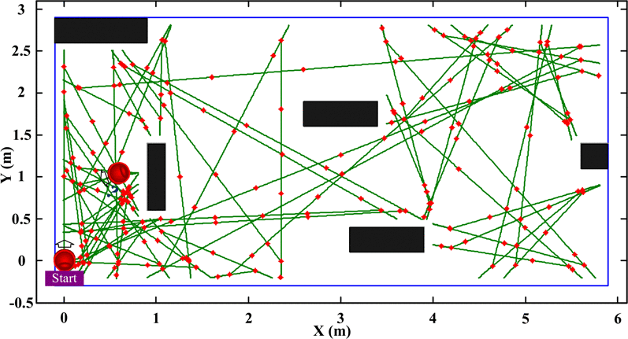
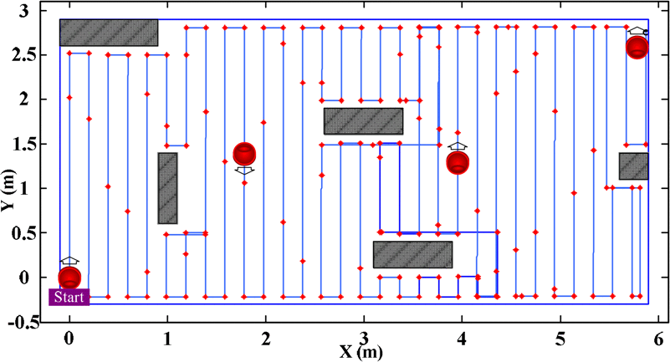
In 2012, at The 1st IEEE Global Conference on Consumer Electronics, was proposed an adaptive iterative learning algorithm for planning of the path of a robovac with low-cost sensors.
Recently, the manufacturers are focusing only in cleaning path planning and keep the return path on the back burner.
When the work is completed or the battery of the robot is low, the cleaner starts searching for the base location. If the robot is in a more complex environment, the return path may result in the power being exhausted.
Simulation of robot coordinate for random walk
Simulation of the cleaning mode with path planning

Slide 11
Conclusions
Compared with a few years ago, the robotic vacuum cleaner market has evolved a lot, but still has a large margin of progression and it is certain that will continue to grow.
Nowadays, according to Zhe Zhang (PerceptIn CEO), obstacles such as dog dirt, cables and shoes remain very difficult for robots to navigate around.

Slide 12
Bibliography
Bai, Ying-Wen and Ming-Feng Hsueh. 2012. "Using an adaptive iterative learning algorithm for planning of the path of an autonomous robotic vacuum cleaner". https://doi.org/10.1109/GCCE.2012.6379640.
Aravind, G., et al. 2014. “A Control Strategy for an Autonomous Robotic Vacuum Cleaner for Solar Panels”. https://doi.org/10.1109/TIIEC.2014.018.
Baguley, Richard and Colin McDonald. “Appliance Science: How robotic vacuums navigate”. CNET. (accessed October 11, 2018). https://www.cnet.com/news/appliance-science-how-robotic-vacuums-navigate/
Litzenberger, Gudrun. “Why service robots boom worldwide”. IFR. (accessed October 10, 2018). https://ifr.org/downloads/press/Presentation_PC_11_Oct_2017_1.pdf

Slide 13
“Robotic Vacuum Cleaner”. Wikipedia. (accessed October 11, 2018). https://en.wikipedia.org/wiki/Robotic_vacuum_cleaner
“Robot cleaner hits the shops”. BBC. (accessed October 16, 2018). http://news.bbc.co.uk/2/hi/technology/3031219.stm
Ackerman, Evan. “New Roomba i7+ Has Persistent Maps, Selective Room Cleaning, and Automatic Dirt Disposal”. IEEE Spectrum. (accessed October 14, 2018). https://spectrum.ieee.org/automaton/robotics/home-robots/new-roomba-i7-features-persistent-maps-room-cleaning

